Slide 1
Context Diagram

Slide 2
What is it?
System Context Diagrams are diagrams used in systems design to represent the more important external actors that interact with the system at hand.
This type of diagram usually pictures the system at the center, with no details of its interior structure, surrounded by all its interacting systems, environment and activities.
The objective of a system context diagram is to focus attention on external factors and events that should be considered in developing a complete set of system requirements and constraints.

Slide 3
Context Diagram Building Procedure
Identify the system and its boundaries (the context)
Identify external entities (providers, receivers of system info)
Identify external data flows (input, output)
However, NO DATA STORE !!!
Note: the whole system itself is a process (it receives input and transforms into output)

Slide 4
Vending Machine Example Assumption: there is no revise order option
Submit order
Vending Machine System
Customer
Send order

Slide 5
ATM Example Assumption: ONLY withdrawing money (not transfer, checking balance, or other services….)
Request transaction
ATM System
Customer
Complete transaction
Or
Revise transaction

Slide 6
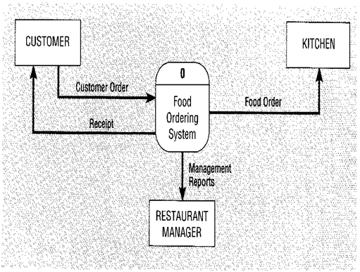
Food Order processing System

Slide 7
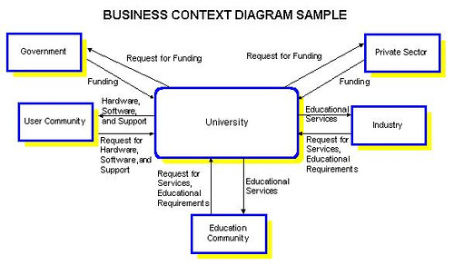
University system Example
Notes:
University External Entities
Government Legislation may impact the overall mission of the University and cause changes to strategic and tactical plans. Government funding may also impact these plans by applying constraints to the University's implementation plans.
The User Community, of the University network, both internal and external, will influence strategic and tactical plans by making requests for hardware, software, or support.
Private Sector Funding, to a lesser extent than Government funding, may also apply constraints on the strategic and tactical plans for the University.
Industry, both inside and outside the province, will influence the strategic and tactical plans for the University by making requests to the University for services and setting new educational requirements for University programs.
The Education Community is made up of universities, public schools, vocational schools, private educational institutions, and university educators. This group will influence the strategic and tactical plans for the University in many ways, for example, by making requests for educational services, gaining a competitive advantage through technology, or gaining advancement in educational techniques.

Slide 8
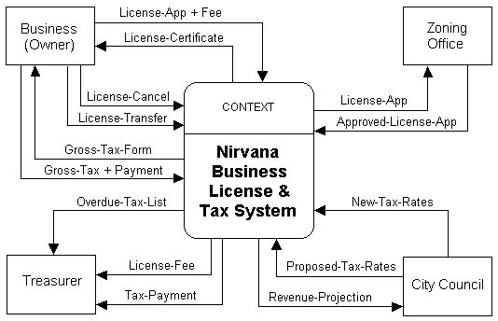
Business and Tax system Example

Slide 9
Context diagram example
A student sends in an application form containing their personal details, and their desired course
The university checks that the course is available.
If the course is available and the student is enrolled in the course, the university confirms the enrolment by sending a confirmation letter that they are registered for the course to the student.
Or if the course is unavailable the student is sent a rejection letter.
What system is being modeled?

Slide 10
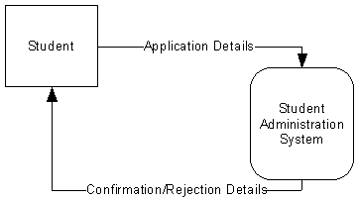
Context diagram example

Slide 11
Practice 1
Letters of complaint received from citizens are entered into a complaints master file by the City Clerk’s office. The date, department code, and a complaint description are stored for each letter. Weekly reports are produced from the complaints master file and given to the City Manager. Two weekly reports are produced: a department summary and a detail report of complaint.

Slide 12
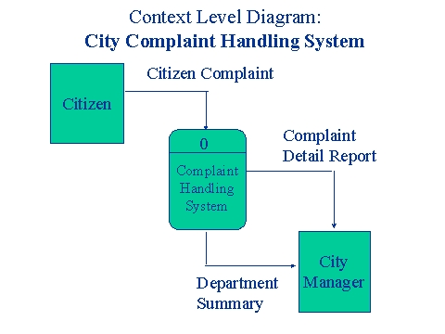
Practice 1 - Answer

Slide 13
Practice 2
The purpose of the campus bookstore is to supply textbooks to students for classes at a local university. The university’s academic departments submit initial data about courses, instructors, textbooks, and projected enrollments to the bookstore on a textbook master list. The bookstore generates a purchase order, which is sent to publishing companies supplying textbooks. Book orders arrive at the bookstore accompanied by a packing slip, which is checked and verified by the receiving department. Students fill out a book request that includes course information. When they pay for their books, the students are given a sales receipt.

Slide 14
Practice 3
The purpose of the plant science office is to document the study results from a wide variety of experiments performed on selected plants. A study is initiated by a researcher who submits a research proposal. After a panel review by a group of scientists, the researcher is required to submit a research plan and schedule. A FDA research permit request is sent to the Food and Drug Administration, which sends back a research permit. As the experiment progresses, the researcher submits experimental notes. At the conclusion of the project, the researcher’s results are reported on an experimental histogram.

Slide 15
Practice 4
Your client, Econ MiniBank, requests for a simple Automatic Teller Machine (ATM) system with the following requirements:
The system must be able to accept a customer's ATM card via a card reader and validate the account number using an account numbers file. The customer's transaction information, on the other hand, is entered via a key panel and also validated by the system. For valid account holders issuing valid transactions, the system determines the transaction type, which can be one of the following : display of account statement, hardcopy of account statement, cash transfers and requests for cheque book.

Slide 16
Practice 4 (con’t)
Transaction information would therefore include items like the customer's request (transaction type), cash transfer amount, and transferee's account number.
For account statement requests, the system retrieves the account information from a customer database and formats the information accordingly depending on whether a hardcopy or display is requested. For cash transfer requests, the cash amount and transferee's account number must be specified. Finally, for cheek book requests, the system uses a valid account number to determine the collection center and collection date from a collection schedule log and prints a collection slip for the customer.

